Slide 1
E - COMMERCE
Olist Store Analysis

Slide 2
Agenda
To provide a high - level overview of the E – commerce Industries we’re tackling
the Precise requirements, we will provide summary of entire project.
Project Background
The Olist Store needs actionable insights into customer behavior, the most preferable payment mode, customer satisfaction and the top performing cities to optimize marketing strategies and inventory management.
Problem
Insights & Summary
At last we will review the significant findings and offer them as a collection of insights and provide summary.

Slide 3




Objectives
Company Current Condition
Increase Company Value
Deliver current condition of the company to know the business performance.
Can increase company value from the new business insight.
Get New Business Insight
Plan for Future Strategy
Get a new business insight that can help to reach a new level of company achievement.
Give the company idea to make the future strategy to handle the obstacle for their business.
3

Slide 4
Project Background
“E-Commerce" is a rapidly expanding unicorn in the technology space that is quickly adjusted to its global reach.
This data provide three years of E-Commerce activities done by different stores, Industries etc. To provide valuable insights related to data, dashboards were built which will be more engaging and extra KPI’s are inclusive in it which will give user required as well as additional information for any Business activities.

Slide 5
Problem
Weekday Vs Weekend Payment Statistics
Number of Orders with review score 5 and payment type as credit card.
Average number of days taken for order delivered for pet_shop
Average price and payment values from customers of sao paulo city
Relationship between shipping days Vs review scores.

Slide 6
Data Collection & Preparation
We collected data from Olist’s database which includes customer orders, Product information, Sellers details and customer reviews.
The dataset spans from 2016-2018 and consists of over 100,000 orders.
The analysis is based on 9 CSV files ,which are cleaned and manipulated to extract valuable insights.
Identify missing and duplicate values in each dataset and treat them accordingly. Also treat all data quality issues associated with the dataset.
Additionally we standardized date formats and handled categorical data using Encoding methods.
For Extracting Different KPI’s, we need to merge the datasets with the help of power query.

Slide 7
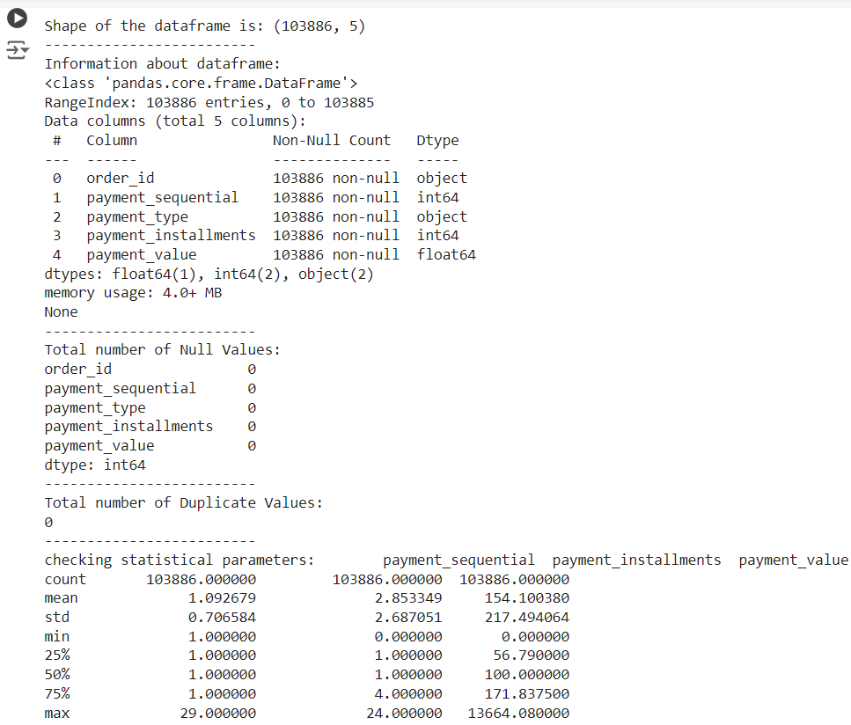
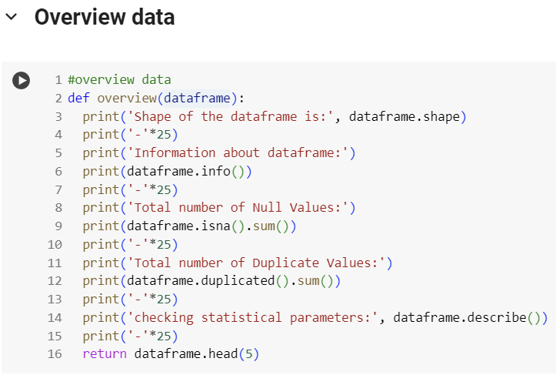
EDA

Slide 8
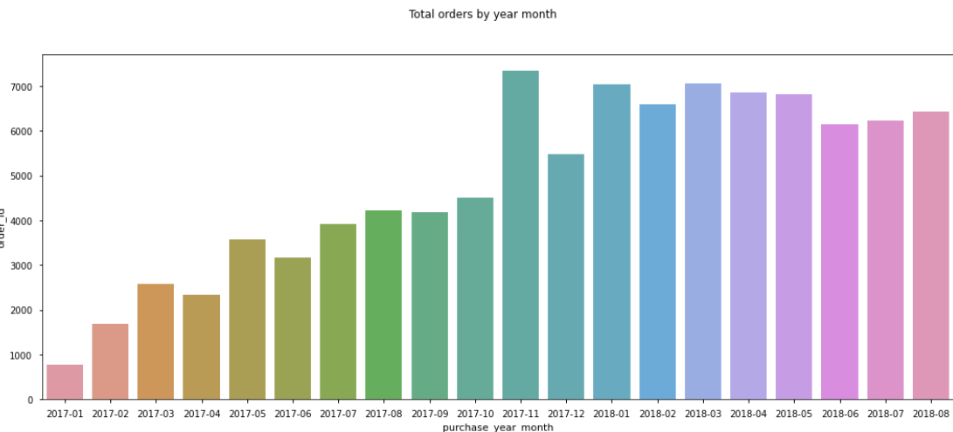
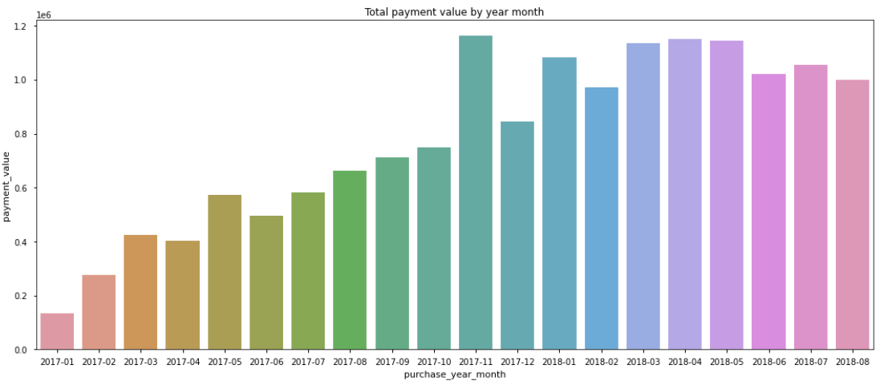
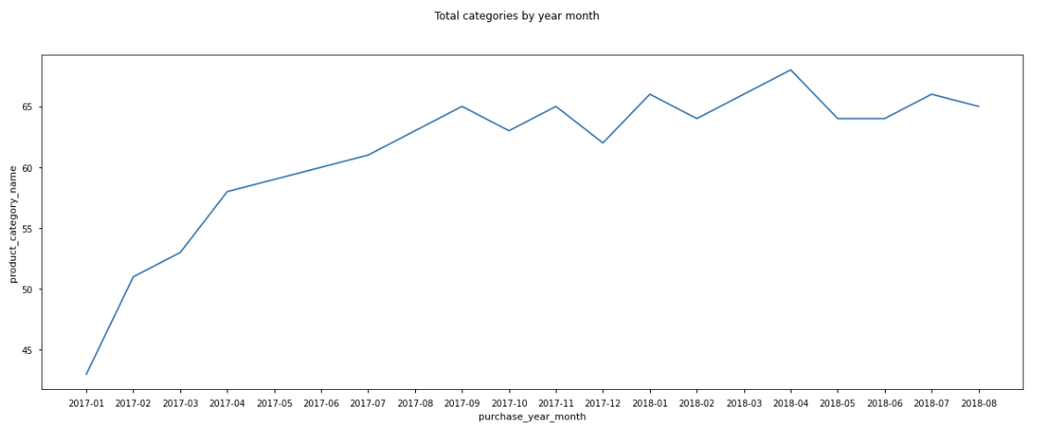
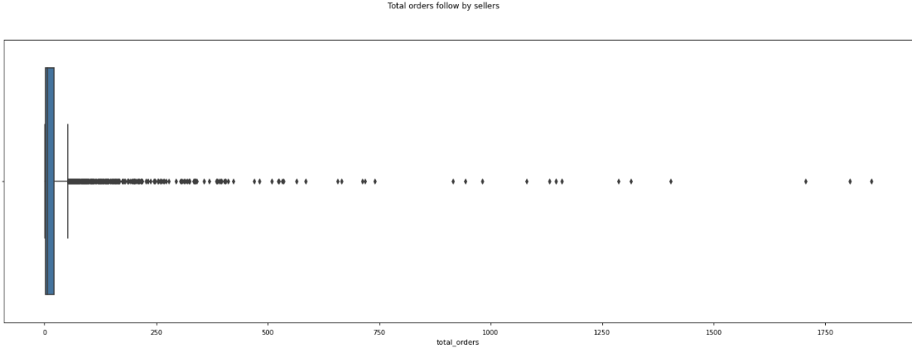
Data Visualization
Total Orders by Year_month
Total Payment_value by Year_month
Total Categories by Year_month
Total Orders followed by Sellers

Slide 9
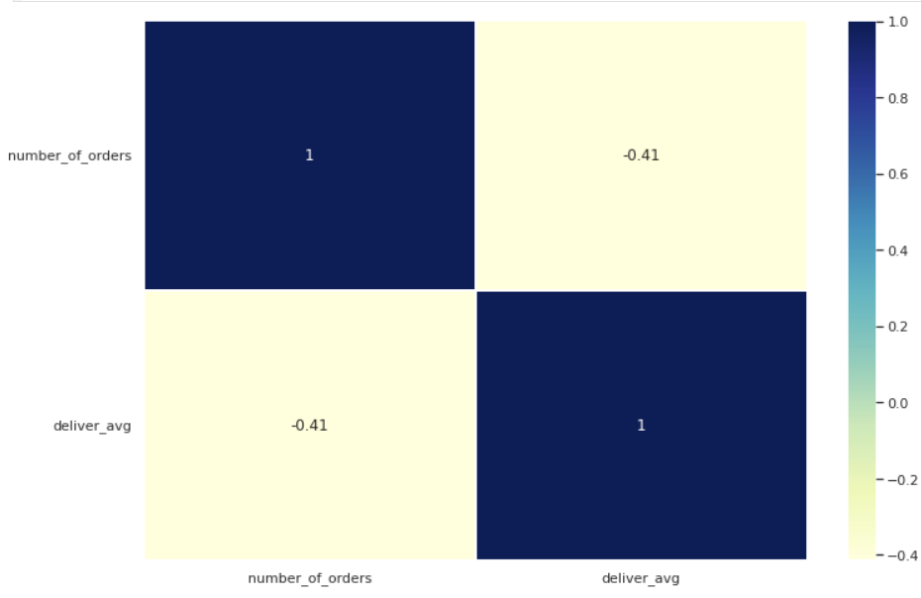
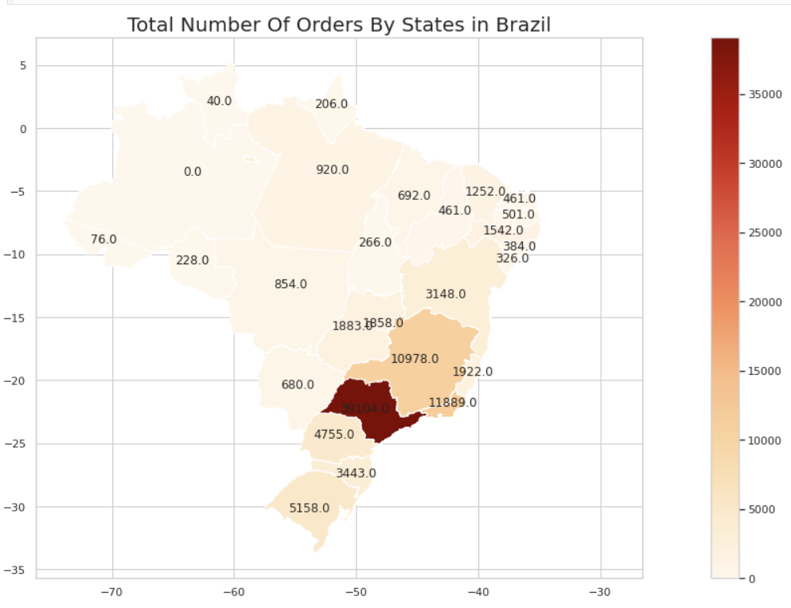
Data Visualization
Number of Orders by Average delivery days
State wise Total number of Orders

Slide 10
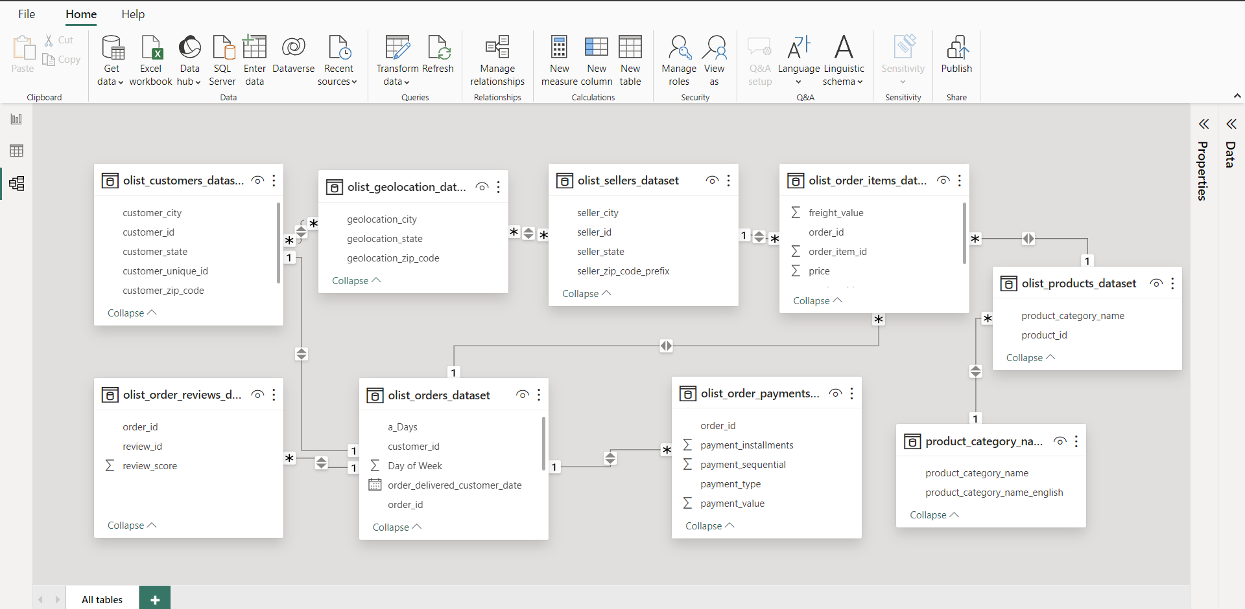
Data Modeling
Build relationships of all datasets by creating bridge table in power query.

Slide 11
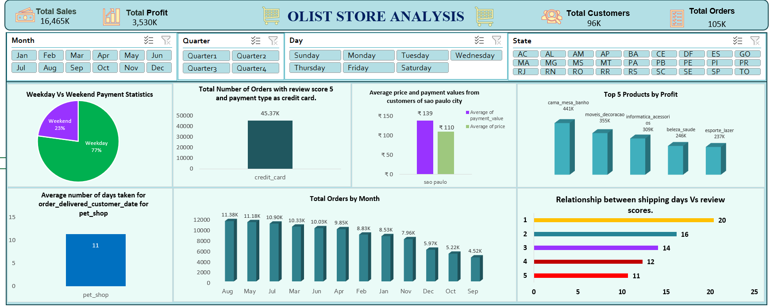
Excel

Slide 12
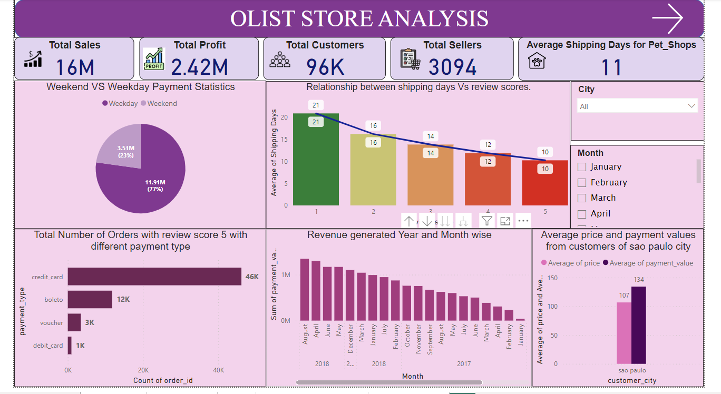
Power BI

Slide 13
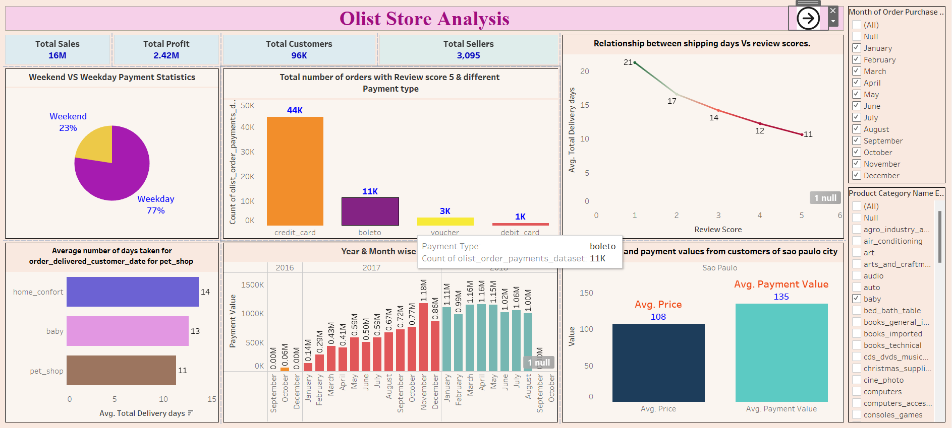
Tableau

Slide 14
Key Insights

Slide 15
Olist store offer 74 product categories.
The Ecommerce store has processed a substantial 99K orders.
The Store has 3094 sellers.
The ratings are given 1, the lowest when the delivery is made within 21 days and 5 when the delivery made within 10 days of order.
The total sales earned by the store is $16M.
The total price invested is $14M.
The Total Profit earned is $2.42M.
Weekday sales account for approximately 77% of the total activity while Weekend sales make up the remaining 23%.
The fact that the average payment value (134) is higher than the average price per product (107) suggests that customers in Sao Paulo are making larger purchases.
While debit cards were the least popular payment option, credit cards were used by the majority of customers, accounting for 74% of all purchases.

Slide 16
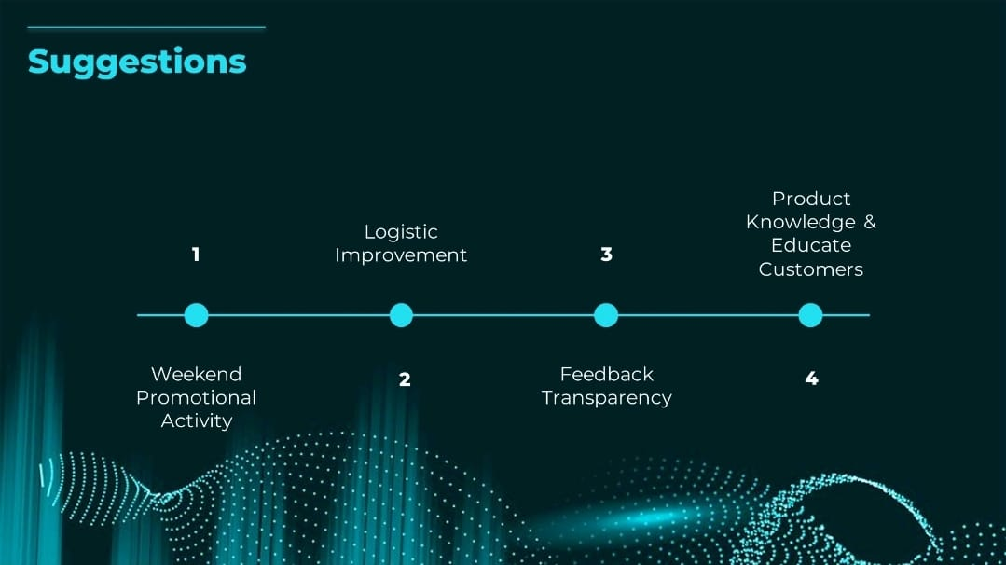

Slide 17
Thank You

